Slide 1
Requirements Engineering
Chapter 8: RE Tool Support
George Edwards
Computer Science Department
University of Southern California
gedwards@usc.edu

Slide 2
Today’s Agenda
Ch. 7 quiz, part 2
Review Ch. 7 quiz, part 1
Ch. 8 lecture
Student presentations
Class project help

Slide 3
Requirements Engineering Tools Features
Represents all “typical” RE objects – e.g. use cases, scenarios, user stories
Support for user defined entities
Multi-user support without collision and versioning issues
Online collaboration
Customizable GUIs
Standard templates (e.g. IEEE 12207, 830)
Verification and validation tools
API access to functionality for customization
Support for traceability
Round tripping
Glossary support

Slide 4
Automated RE Tool Features
Tool Feature | Description
Definition of workflow for requirements | A workflow (states, roles, state transitions) is configurable for requirements.
Automated generation of bi-directionality of traces | When the user creates a trace between artifact A and artifact B it automatically establishes a backward trace from B to A.
Definition of user-specific trace types | An authorized user can define trace types and assign names.
Suspect traces | When a requirement changes the tool automatically highlights all traces related to this requirement for checking and updating traces.
Long-term archiving functionality | All data in the tool can be archived in a format accessible without the tool if necessary

Slide 5
Traceability
Traceability is concerned with the relationships between requirements, their sources and the system design
Source traceability
Links from requirements to stakeholders who proposed these requirements
Requirements traceability
Links between dependent requirements
Design traceability
Links from the requirements to the design

Slide 6
Best Practices for Automated Traceability
Trace for a purpose
Determine which linkages are truly important
Avoid generating extraneous links
Define a suitable trace granularity
e.g., should linkages be at a package, class, or method level?
Support in-place traceability
Provide traceability between artifacts as they reside in their native environments
Use a well-defined project glossary
Create during initial discovery meetings with stakeholders
Use consistently throughout the RE process

Slide 7
Best Practices for Automated Traceability
Construct a meaningful hierarchy
Experimental results show that hierarchically organized requirements are more susceptible to intelligent linking software
Avoid overloaded terminology
Terms with different semantics in different domains
Create rich content
Incorporate rationale and domain knowledge in each requirement
Use a process improvement plan
Identify areas of inefficiency and implement corrective steps

Slide 8
Requirements Engineering Tools
DOORS
Caliber
Dimensions RM
Other types of tools
FreeMind
Kanbanery

Slide 9
DOORS (IBM)
Web-based, feature-rich requirements management system
Requirements and artifacts stored in a DB
Multiple different views of requirements
Imports/exports to Word, Excel, etc.
Allows definition of traceability links, custom attributes, etc.
Built on IBM Jazz platform
Integrates with other IBM products for full lifecycle support
Requires more training due to large number of features, complexity of the interface
https://www.youtube.com/watch?v=qYK7_g4Fy44

Slide 10
Caliber (Borland)
Features include:
Centralized repository
Customizable GUI
Traceability across the lifecycle
Online glossaries
Source: http://www.volere.co.uk/tools.htm

Slide 11
Caliber Demo
https://www.youtube.com/watch?v=vvDAQC3quBs

Slide 12
Dimensions RM (Serena)
Oracle-based
Enables management and traceability of requirements, design, tests, tasks, and other development information
A class definition tool used to model any type of hierarchical project data (requirement document, hierarchies, system element structure and WBS).
Generic relationships within the hierarchies can be established to cross-reference link information
Online collaboration capability

Slide 13
Dimensions RM Demo
http://www.slideshare.net/serenasoftware/presentation-and-demo-dimensions-rm?mkt_tok=3RkMMJWWfF9wsRonsqTKcO%2FhmjTEU5z17%2BktWaKxhYkz2EFye%2BLIHETpodcMT8NnNb7YDBceEJhqyQJxPr3AKtQN3t1zRhjmCA%3D%3D

Slide 14
FreeMind (open source)
Free “mind mapping” software written in Java
Mind maps are simple “graphs” (in the CS sense) of concepts
Start with a central concept
Branches representing related ideas radiate from the central concept
Useful for brainstorming, task analysis, laddering, traceability, JAD, focus groups, etc.

Slide 15
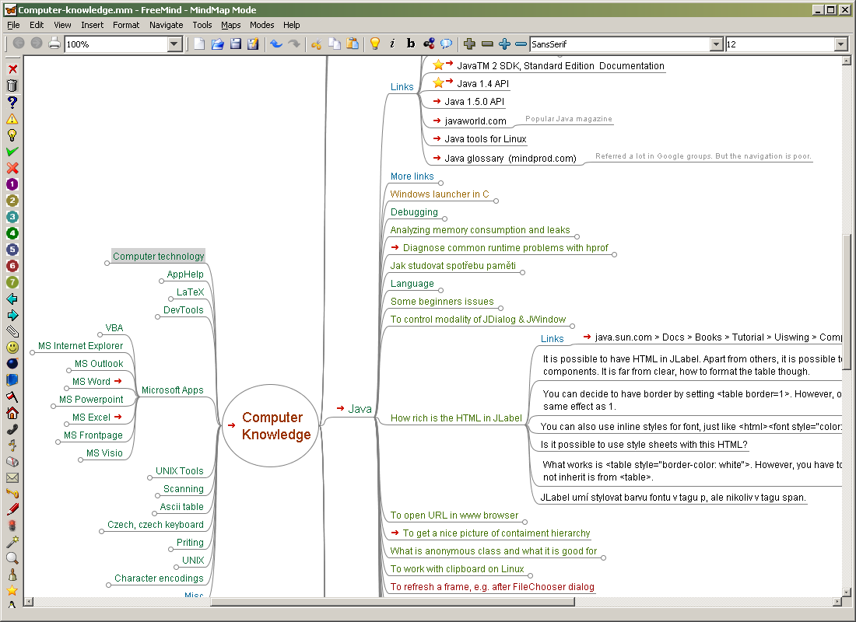
FreeMind
Source: http://freemind.sourceforge.net/FreeMind-computer-knowledge.png

Slide 16
FreeMind Demo
https://www.youtube.com/watch?v=OWPPZGECd_4

Slide 17
Kanban tools
Kanban is a process management system for tracking the status of work items (tasks)
Work items are captured on a Kanban “board”
The board includes set of process steps (“bins”)
Work items are moved between steps as their status changes
Process steps, task types, work items, user roles, etc. are customizable
In agile methods like Scrum and XP, work items are user stories
Common process steps are:
Planned, In progress, Done
Product backlog, Release backlog, Sprint backlog
Specification, Development, Testing, Deployment

Slide 18
KanbanFlow Demo
https://www.youtube.com/watch?v=VfFkjqBtwTg

Slide 19
Other Tools
http://www.volere.co.uk/tools.htm

